Slide 1
Drug Adherence
and
Strategies for Compliance

Slide 2
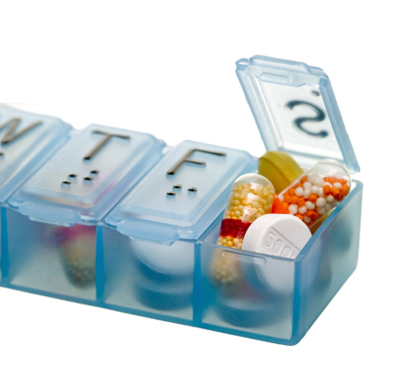
Medication adherence
“The degree to which the person’s behavior corresponds with the agreed recommendations from a health care provider.”
– World Health Organization
Notes:
TITLE PAGES
Smallest text is 40pts.
Next size is 48pts.
Largest is 60pts.

Slide 3
Definitions of Adherence and Compliance
Adherence is the term used to describe the patient’s behavior of taking drugs correctly – in the right dose, with the right frequency, and at the correct time
A critical aspect of adherence is the patient’s involvement in deciding whether or not to take the drugs
Compliance means the patient does what he or she has been told to do by the doctor/pharmacist

Slide 4
Need for Adherence
Replacement Therapy
Maintenance of pharmacological effect
Maintenance of serum levels of drugs
Public health importance
Chronic conditions

Slide 5
Non compliance
Primary
Secondary
Intentional
Intelligent nonadherence
Unintentional
Adherent : > 80%
Partially : 70-80 % adherent
Non- adherent: < 70%
% Compliance = NDP-NME x 100
NDP
NDP = No. of doses prescribed
NME = No. of medication errors

Slide 6
Determinants of Adherence
Predisposing factors
Enabling factors
Reinforcing factors

Slide 7
Reasons for non-compliance
Poor standards of labelling
Inappropriate packing
Complex therapeutic regimens
Nature of medication
Deliberate deviation

Slide 8
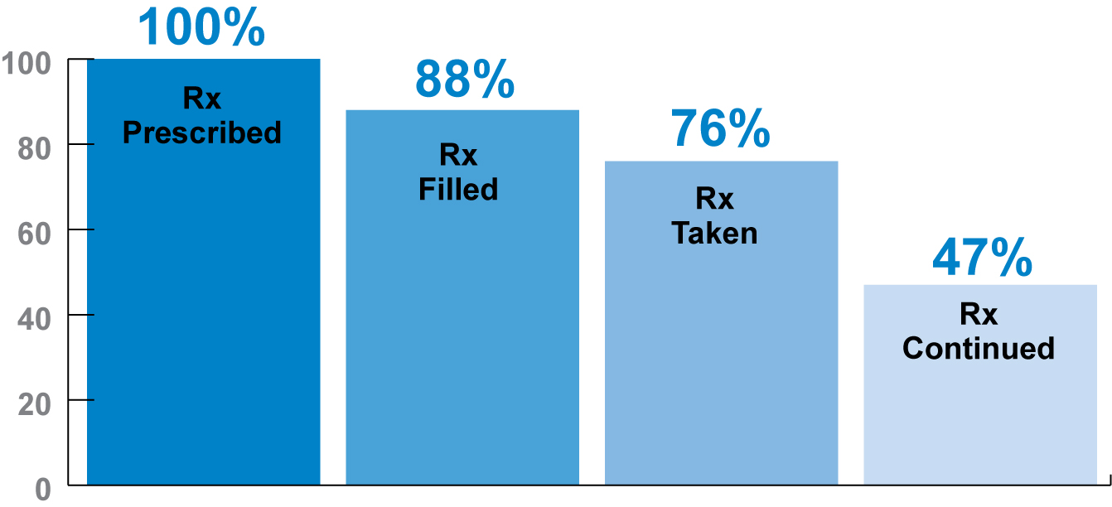
Medication adherence
22% of U.S. patients take less of the medication than is prescribed
American Heart Association: Statistics you need to know. http://www.americanheart.org/presenter.jhtml?identifier=107
Accessed November 21, 2007.
Notes:
Failure to adhere to prescribed medications can result in:
Poor health outcomes
Increased hospitalization
Increased costs
Decreased quality of life
Patient death
“Of all medication-related hospital admissions in the United States, 33 to 69 percent are due to poor medication adherence, with a resultant cost of approximately $100 billion a year.”
Osterberg L, Blaschke T. Adherence to Medication. NEJM 2005;353:487-497

Slide 9
Statin adherence as measured by proportion of days covered (PDC)
Below 80% PDC was considered suboptimal adherence.
Within 3 months, mean PDC had fallen to 79%.
After 3 months, 40% of patients had suboptimal adherence.
After 12 months, 61% had suboptimal adherence.
Benner JS, Glynn RJ, Mogun H, Neumann PJ, Weinstein MC, Avorn J. Long-term persistence in use of statin therapy in elderly patients. JAMA 2002;288:455-461
Notes:
TITLE PAGES
Title is 40pts.
Bullet/paragraph text is 18pts.
Largest is 60pts.

Slide 10
Adherence to statins after two years
Jackevicius CA, Mamdani M, Tu JV. Adherence with statin therapy in elderly patients with and without acute coronary syndromes. JAMA 2002;288:462-467
Notes:
TITLE PAGES
Title is 40pts.
Bullet/paragraph text is 18pts.
Largest is 60pts.

Slide 11
Why adherence matters
“Of all medication-related hospital admissions in the United States, 33 to 69 percent are due to poor medication adherence, with a resultant cost of approximately $100 billion a year.”
Results of failure to adhere to prescribed medications:
Increased hospitalization
Poor health outcomes
Increased costs
Decreased quality of life
Patient death
Benner JS, Glynn RJ, Mogun H, Neumann PJ, Weinstein MC, Avorn J. Long-term persistence in use of statin therapy in elderly patients. JAMA 2002;288:455-461
Notes:
TITLE PAGES
Title is 40pts.
Bullet/paragraph text is 18pts.
Largest is 60pts.

Slide 12
Statin therapy adherence demonstrated to improve three specific outcomes
West of Scotland Coronary Prevention Study (WOSCOPS). Compliance and adverse event withdrawal:their impact. Eur Heart J 1997;18:1718-1724
Notes:
TITLE PAGES
Title is 40pts.
Bullet/paragraph text is 18pts.
Largest is 60pts.

Slide 13
Poor adherence increases total health care costs
Hypertensive Patients and Total Annual Costs
Smith DL. The effect of patient non-compliance on health care costs. Medical Interface 1993:April; 74-84
Notes:
Use this slide to talk about total costs being decreased for Managed Care. This will build on the previous slide.

Slide 14
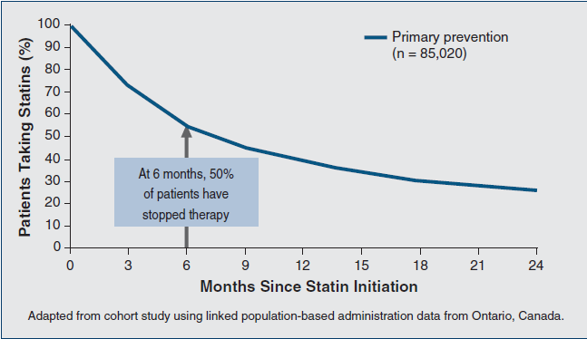
Nonadherence to Statin Treatment begins early
Adherence continues to drop over time, particularly when treating the asymptomatic patient
Adapted from cohort study using linked population-based administration data from Ontario, Canada (N=85,020). Jackevicius et al. JAMA. 2002;288:462-467.
Notes:
Reference
1. Jackevicius CA, Mamdani M, Tu JV. Adherence with statin therapy in elderly patients with and without acute coronary syndromes. JAMA. 2002;288:462-467.
This slide shows that adherence to statin treatment drops over time, particularly when treating the asymptomatic patient. At 6 months, nearly 50% of primary prevention patients have already stopped therapy.¹
A study involving elderly Canadian patients showed that 2-year adherence to statins was 25.4% among patients without coronary disease who were receiving statins for primary prevention (n=85,020). Patients’ adherence continually diminished in a progressive manner from initiation of therapy through 2-year follow-up, with at least 25% of patients discontinuing statin therapy by 6 months. The authors of this study concluded that many patients initiating statin therapy may receive limited benefits from statins because of premature discontinuation.¹

Slide 15
Global Medication Adherence is 50%
Medication Adherence
Co-morbidities
Notes:
Let’s look at Medication Adherence. In 2003, the World Health Organization (WHO) reported that global medication adherence among patients with chronic diseases averages 50 percent, and that adherence rates decrease as the number of co-morbid diseases increase. Medication adherence is an important contributor to effective chronic condition management. Medications are often the primary factor preventing older adults from developing serious complications from chronic illness. Conversely, poor medication adherence is the leading cause of increased health care costs, morbidity, and early death.

Slide 16
WHO’s Five Dimensions of Adherence
Social & Economic
Health Care System
Condition Related
Therapy Related
Patient Related
Notes:
The World Health Organization (WHO) determined that the interplay of five sets of factors, termed dimensions, are important for older adults to adhere to medication regimens. We will discuss each of these dimensions and the most common barriers to medication adherence associated with that barrier. Reflecting on the Chronic Care Model, self-management support strategies to over-come barriers are suggested.

Slide 17

1. Social & Economic
Community Support
Economic
Use Pictures When Teaching
Use pictures when giving instructions
Read Back
Have the patient read back the instructions
Prescription for Medication
Notes:
If patients are living alone or do not have a social support system, health care providers should consider community-based services for medication assistance.

Slide 18

2. Health Care System
Provider-Patient Relationship
Provider related factors
Provider readiness - knowledge, skills
Counseling
Patient education
Medication alerts, e.g., charts, diaries, etc.
Adherence team
Using two-way communications and asking open ended questions fosters encouragement.
Shared Decision Making
Notes:
The quality of the health care provider-patient relationship is one of the most important health system factors impacting adherence. A good relationship with encouragement and reinforcement is a crucial element in adherence. Health-care system barriers include difficulties in scheduling appointments, lack of providers, use of restrictive and changing formularies, and increased drug/co-payment costs. Many older patients have multiple illnesses and are treated by several providers. Continuity and coordination of care are particularly important for older patients.

Slide 19
3. Condition Related
Chronic conditions, such as hypertension, that lack symptoms highly impact the level of adherence
People’s belief about the benefits and risks of medications influence whether they abide by a regimen.
Notes:
Chronic conditions and lack of symptoms highly impact the level of adherence. Chronic conditions such as high blood pressure, hyperlipidemia, diabetes, osteoporosis, and depression are common illnesses in which there are few or no symptoms which remind individuals to take their medication. When patients do not perceive that their illness is chronic or requires preventative treatment, adherence is generally poor. Adherence is generally greater for medications that provide symptom relief, as opposed to those used for treatment of a generally asymptomatic condition.

Slide 20
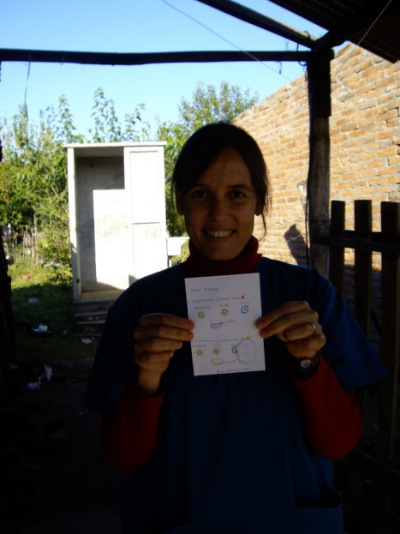
4. Therapy Related
Therapy-related factors include the complexity of medication regimen and unpleasant side effects.
Dosing several times a day may contribute to non-adherence.
Concern about medication side effects remains a powerful barrier.
Notes:
Therapy-related factors include the complexity of medication regimen and unpleasant side effects. Complex medication regimens are a significant factor in deterring adherence. Many older adults have chronic conditions and/or multiple conditions leading to the use of multiple medications at the same time as a necessary part of their care. Studies have shown that medication adherence rates decrease when the treatment is long-term and involves multiple medications that must be taken concurrently.

Slide 21
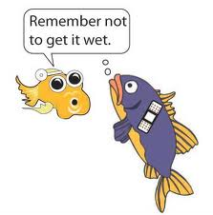
5. Patient related factors
Patient readiness/commitment
Forgetfulness (e.g., restaurant, too busy )
Travel away from home
Lifestyle
Lazy about going to the drug store
Confused about dosage
Feeling sick
Feel well (rare reason)
Depression - Life events, stress (e.g., death in family)
Cultural - Don’t believe in the treatment
Socioeconomic/ Financial (wait until pay day, take 1/2 dose to delay renewing prescription)

Slide 22

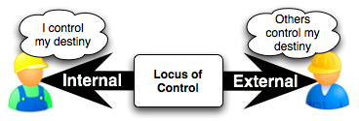
Patients at higher risk:
Multiple daily dosing
qd < bid < tid, < qid
Patient perceptions
effectiveness, side effects, cost
Poor communication
patient practitioner rapport
Psychiatric illness
less likely to comply

Slide 23
Factors affecting adherence
Patient-related factors
Patient readiness/commitment
Forgetfulness
Travel away from home
Lifestyle
Depression
Cultural
Socioeconomic
Etc

Slide 24
Patients at higher risk:
Multiple daily dosing
od < bid < tid < qid
Patient perceptions
effectiveness, side effects, cost
Poor communication
patient practitioner rapport
Psychiatric illness
less likely to comply

Slide 25
Factors affecting adherence
Other factors
Cost

Slide 26
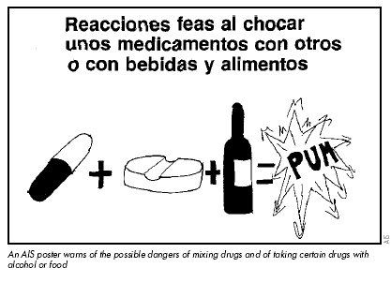
Factors affecting adherence
Regimen/Drug-related factors
Pill burden
Frequency
Side effects
Food restrictions
Drug interactions
Storage

Slide 27
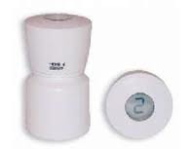
Measuring Adherence
Directly Observed Therapy (DOT): Theoretically associated with 100% adherence. Labor intensive and impractical outside institutional setting
Electronic pill bottle monitoring, e.g., Medication Event Monitoring Systems (MEMS): Expensive. A patient can remove doses but then not take them. Cannot be used on blister packs.
Patient self-report: Convenient and inexpensive.
Pill count: Labor intensive

Slide 28
Measuring adherence
Plasma drug levels: Objective measure
Pharmacy Records/ prescription refill monitoring
Viral load assay: Not a primary measure of adherence. Surrogate marker: can be helpful when used with patient self-reports

Slide 29
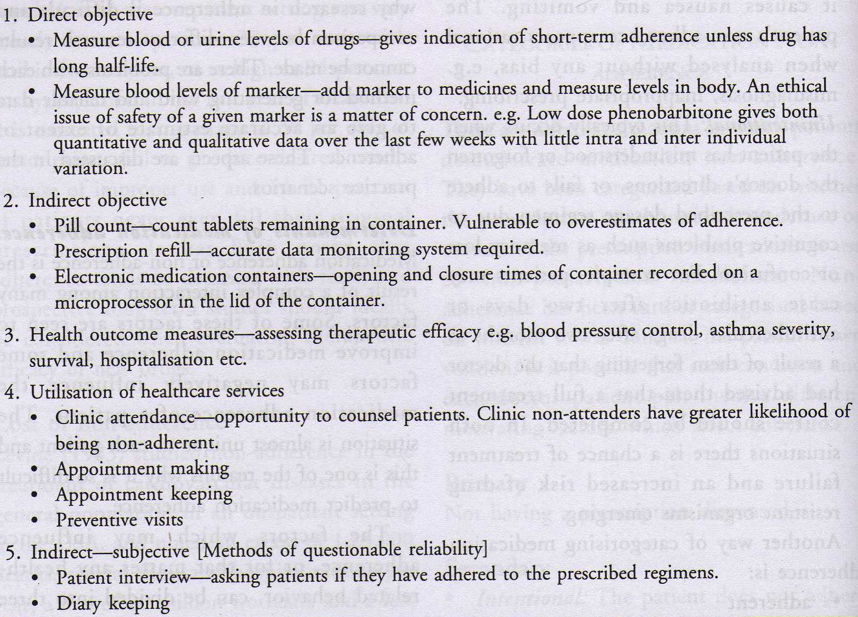
Methods to detect compliance
/ Residual tablet counting

Slide 30
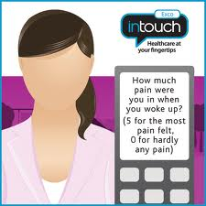
Methods to detect non compliance
Drug Analysis
F x D
C_{pss} =
Cl x T
Dose input rate
FD/T = C_{pss x} Cl
Determination of plasma conc. of the drug will give the most accurate and direct indication of the dose taken

Slide 31
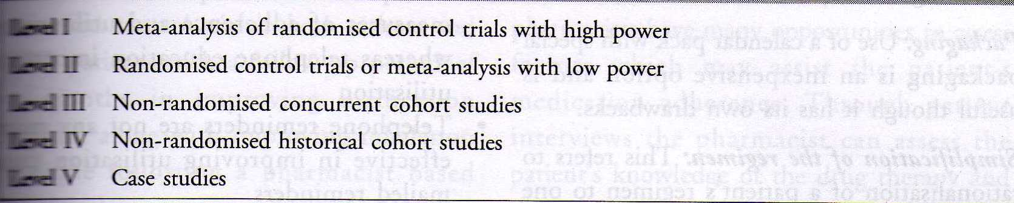
Levels of evidence for adherence studies

Slide 32
Adherence: General comments
One of the key determinants of treatment success
Poor adherence leads to virologic failure, evolution of drug resistance, and subsequent immunologic and clinical failure
Important to counsel patients carefully before initiating therapy. Involves clinicians, nurses, pharmacist, family etc
Therapy should not be started on first clinic visit: treatment adherence counseling is necessary to prepare the patient in order to maximize adherence
Once treatment has started, continued monitoring and support for adherence is necessary

Slide 33
Strategies for improving compliance
Simplification of therapeutic regimen
Number of medicines
Dosing frequency
Improving standards of dispensing practice
Development of suitable medication packaging
Supplementary labeling
Patient counseling and education
Name and purpose of the drug
When and how to take medication
Precautions
Possible side effects
DDI, FDI
Duration of therapy
Action in case of missed dose
Lookout for evidence of therapeutic efficacy
Notes:
Multiple interventions

Slide 34
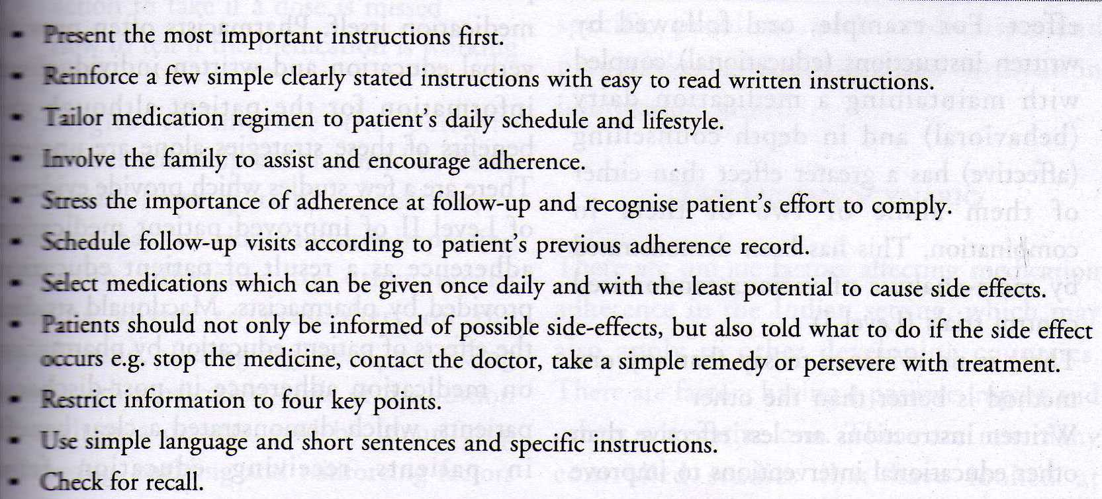
Strategies for improving compliance

Slide 35
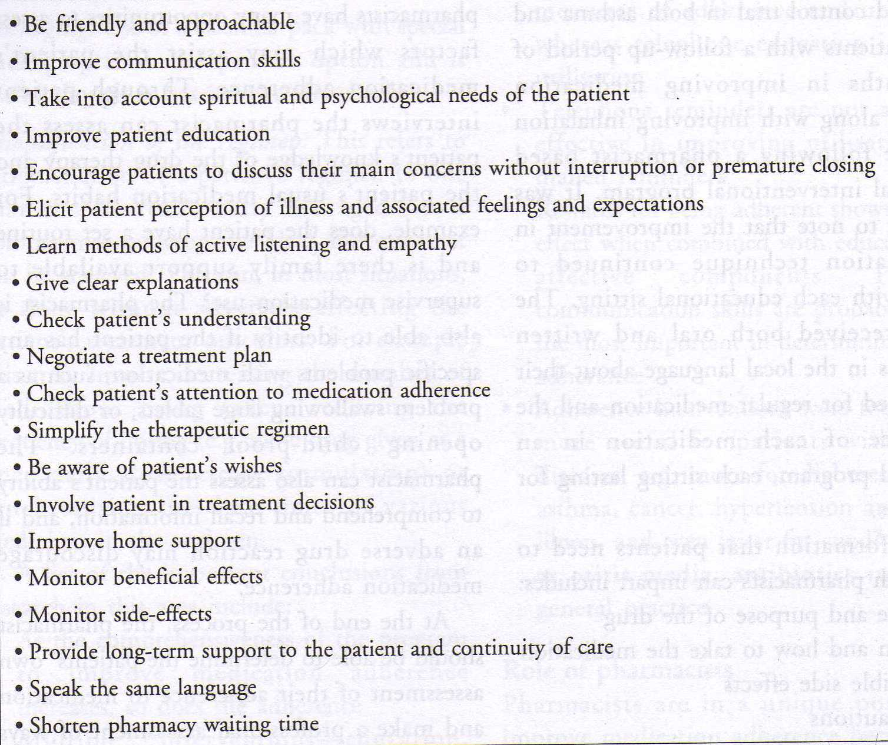
Strategies for improving pharmacist- patient relationship

Slide 36
Benefits of improved compliance:
For:
Patients - better outcomes and quality of life
Practitioners – healthier, more loyal patients
Managed care - lower total HC expenditures
Pharmaceutical Industry - increased sales

Slide 37
Overview
Over 40 years of research on treatment adherence—not much has changed—old models of care don’t work
Patients want more information, help concerning their drug therapy
Patients manage their illness, not us
In year two of a chronic illness, rate of adherence drops below 50%

Slide 38
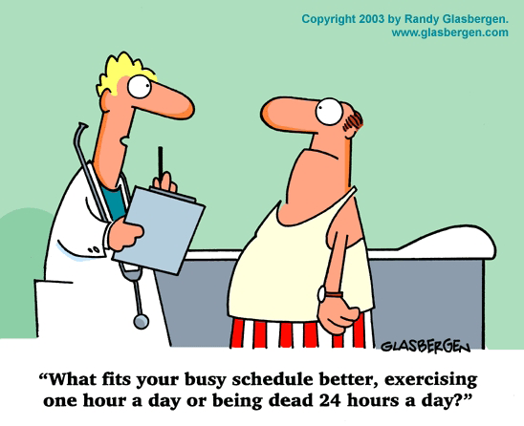
What To Remember
When faced with ambivalence or resistance, EXPLORE, don’t EXPLAIN

Slide 39
Motivational Interviewing
A Definition
Motivational interviewing is:
person-centered
directive
method of communication for enhancing intrinsic motivation to change by exploring and resolving ambivalence

Slide 40
The Five General Principles of Motivational Interviewing
Roll with resistance
Express empathy
Avoid argumentation
Develop discrepancy
Support self-efficacy
R E A D S

Slide 41
Roll resistance
Patient: “I don’t like the idea of taking blood pressure medicine. I hear it can have bad side effects?”
Pharmacist: “It really is your decision. I would like to address your concern about side effects if I might…”

Slide 42
Avoid arguing
Patient: “You’re not my doctor! I don’t have time to wait for some pharmacist to tell me about this medicine.”
Pharmacist: “Mrs. Rogers, I see you’re in a hurry, so I will only cover three critical things you need to know about taking the medicine. Would that be ok?”

Slide 43
Support self- efficacy
“Mr. Simmons, it’s great that you take your diabetes medicine every day as you planned. Keep it up! What things do you do to stay on track?”
“I really believe you‘re on your way to better health since you are thinking about lowering your cholesterol.”

Slide 44



